Slide 1
System Approach & scalability for the Future
Metro Car Production, Quality & Warehouse Systems — Appcart | Titagarh
Prepared for Management Review

Slide 2
PRESENTATION OVERVIEW
Agenda
01
Original Project Scope
Planning, Production, Tablet App, Quality & Inspection
02
Additional Modules & Enhancements
Warehouse, Quality, Manpower, Transfers, Planning
03
Key Gaps & Recommendations
Root causes and proposed process fixes
04
Dashboards, Roadmap & MIS
Management visibility and standardization path
Project Scope vs. Additional Work
2

Slide 3




Original Project Scope
Planning Module
Production Module
Monthly & weekly Excel import; daily, weekly, monthly and status-wise progress reports
Station-wise activity lists, per-car activity schedules, work allocation by station
Production Tablet App
Quality Module & QA Inspection
View assigned activities, start/complete work, update activity status
QA checklist import; inspection, rework notification and re-inspection flow
Original Project Scope
3

Slide 4
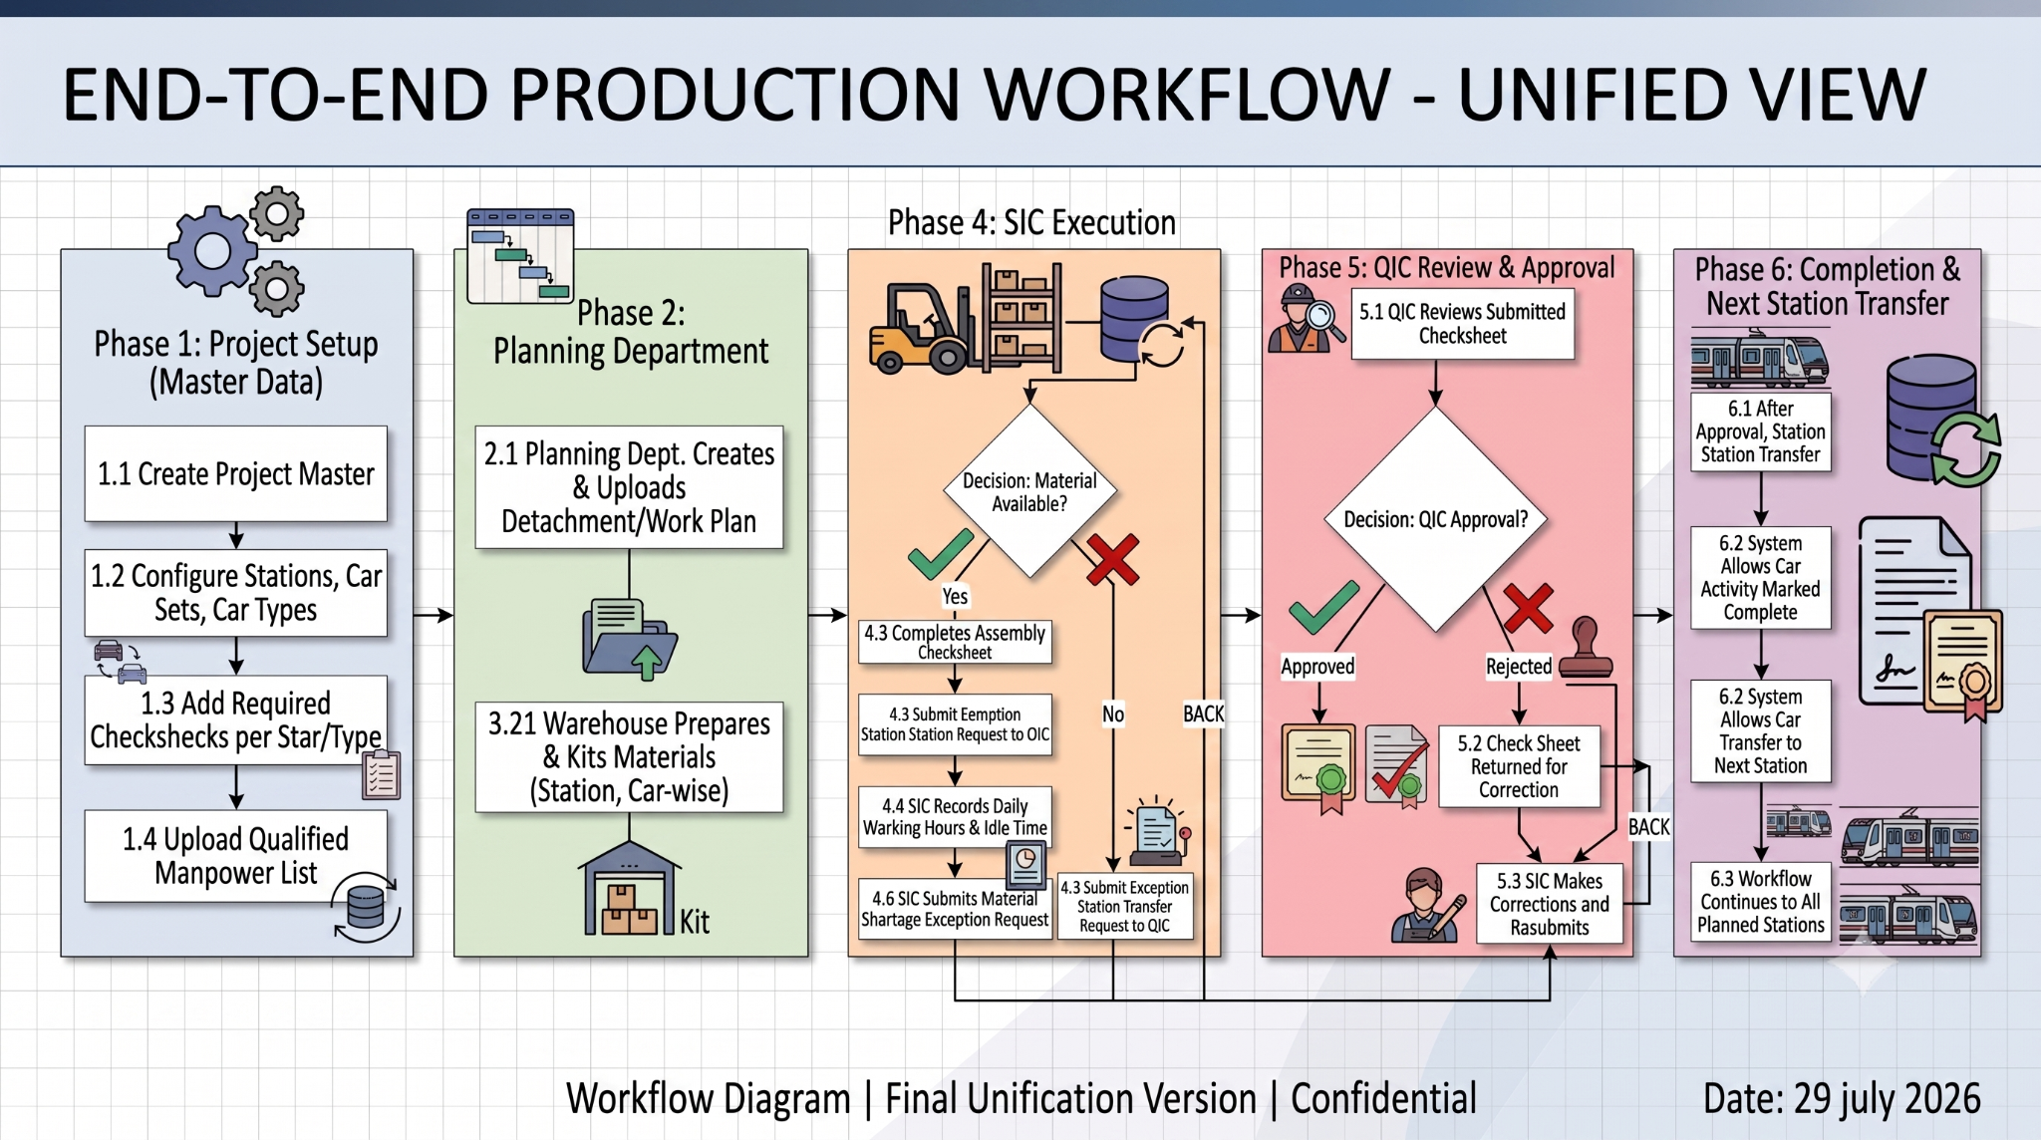

Slide 5


1.1 Planning Module
Excel Import
Reports
Monthly Planning Excel Import
Weekly Planning Excel Import
Daily Progress Report
Weekly Progress Report
Monthly Progress Report
Status-wise Progress Reports
Original Project Scope
5

Slide 6
1.2 – 1.3 Production Module & Tablet App
Production Module
Production Tablet App
The system generates:
View assigned activities
Start / Complete activities
Update activity status
Station-wise activity list
Activity schedule for each Metro Car
Production work allocation by station
Original Project Scope
6

Slide 7
1.4 – 1.5 Quality Module & QA Inspection Process
Import QA checklists into the system; QA inspects completed station activities against the checklist.
1
2
3
4
5
QA views completed
station activities
→
QA fills the inspection
checklist
→
If failed: Station
In-charge notified
on tablet
→
Rework performed;
marked completed
→
QA performs
re-inspection
Failed activities loop back through rework and re-inspection until passed.
7

Slide 8
Additional Modules
& Enhancements
Work delivered beyond the original scope of work

Slide 9

ADDITIONAL MODULES & ENHANCEMENTS
Warehouse Module
Capabilities Delivered
BEFORE
Activity was blocked if material was unavailable
Material Kitting based on Planning
Material Kitting Dashboard
Material Forecasting
Material Status Monitoring (Issued / Not Kitted / Shortage)
Material Kitting Status on Tablet
AFTER (Material Shortage Workflow)
Workflow modified to allow production to continue even during material shortages
Additional Modules & Enhancements
9

Slide 10
ADDITIONAL MODULES & ENHANCEMENTS
Quality Module Enhancements
Dynamic Quality Checksheet Builder
Variant-wise Checksheet Creation
SIC Inspection Module
QIC Inspection Module
Quality Checksheet Printing
Quality Dashboard
300+
Dynamic Quality Checksheets created
(variant-wise, e.g. DTG)
Additional Modules & Enhancements
10

Slide 11


ADDITIONAL MODULES & ENHANCEMENTS
Qualified Manpower & Manpower Monitoring
Qualified Manpower Module
Manpower Monitoring Module
Qualified manpower mapping for each station
Worker qualification management
Expected manpower per station & process time
Qualified manpower assignment
Actual process time & idle time tracking
Planned vs Actual Manpower Dashboard
Planned vs Actual Process Time Dashboard
Additional Modules & Enhancements
11

Slide 12
ADDITIONAL MODULES & ENHANCEMENTS
Exceptional Station Transfer Workflow
SIC
QIC
⇄
✓
QC
SIC raises Exceptional
Transfer Form
→
QIC Approval
Process
→
Vehicle transferred
between stations
→
Transfer details
auto-displayed
→
Transfer-specific
quality checklist
Additional Modules & Enhancements
12

Slide 13



ADDITIONAL MODULES & ENHANCEMENTS
System Enhancements
Email Automation
Notification And Alerts
WhatsApp Integration
Automated department-wise reports for planning, forecasting, and delay prevention.
Real-time notifications and alerts to keep users updated and prevent delays.
Notifications and updates delivered via WhatsApp
Additional Modules & Enhancements
13

Slide 14

Key Gaps Identified
Material kitting is currently based on Production Orders instead of Planning.
Delayed material kitting affects planned production schedules.
Production Orders and Planning are not fully synchronized.
Resistance in adding the data into system at required time.
Key Gaps & Recommendations
14

Slide 15

Recommendations
Production Planning
System Notifications
Finalize Production Orders before Planning starts
Complete Material Kitting before scheduled production activities
SIC / QIC task notifications
Material Kitting reminders
Material Forecast email reports
Delay notifications
Key Gaps & Recommendations
15

Slide 16
Required Management Dashboards
Planning Dashboard
Warehouse Dashboard
Production Dashboard
Quality Dashboard
Dashboards, Roadmap & MIS
16

Slide 17




Quality Checksheet Enhancement
Upgrade the Quality Checksheet module to support:
Form-based Checksheets
Item-wise Checksheets
Dynamic Layouts
Standardized Formats
Dashboards, Roadmap & MIS
17

Slide 18
Our Suggestions for Monitoring of KPI’s
Management typically tracks a mix of production, quality, supply chain, financial, and compliance metrics.
Given the system we have deployed so far (Planning → Production → Quality → Warehouse → Manpower → Dashboards), here's how these usually map to real management KPIs:
Dashboards, Roadmap & MIS
17

Slide 19
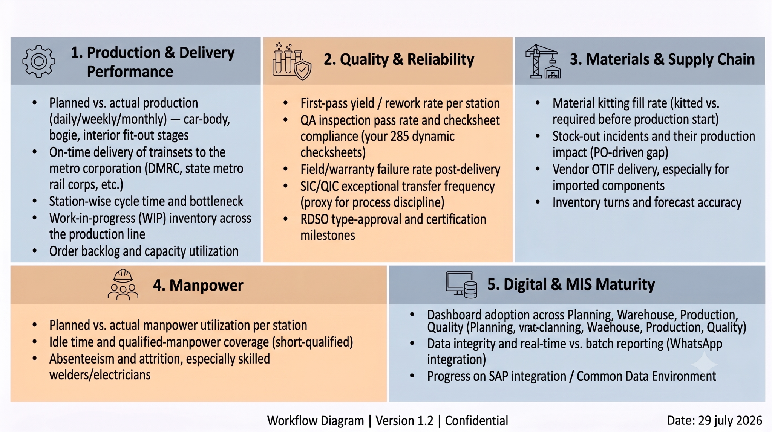

Slide 20



MIS Reports
Station-wise MIS
Assembly-wise MIS
Train Set-wise MIS
Manpower MIS
PENDING
Dashboards, Roadmap & MIS
19

Slide 21
Future Standardization
Standardized Planning Excel Format
1
Standardized Quality Checksheet Format
2
Common Data Environment (CDE)
3
SAP Integration
4
Common Data Repository
5
Dashboards, Roadmap & MIS
20

Slide 22
Thank You
Discussion & Next Steps

Slide 23
HOW THE MODULES CONNECT
System Architecture & Data Flow
Planning Module
Warehouse Module
Qualified Manpower
Excel import (monthly / weekly)
Material kitting & forecasting
Station-wise worker mapping
Production Module (SIC)
Tablet App
Manpower Monitoring
Station activity list & scheduling
View / start / complete
Planned vs actual
Rework loop
Quality Module — QA Inspection (QIC)
Exceptional Station Transfer Workflow
Checklist, inspection, rework, re-inspection
SIC / QIC approval & transfer checklist
Management Dashboards & MIS
Future: SAP Integration & Common Data Environment
Planning · Warehouse · Production · Quality
Standardized formats & shared repository
Original Project Scope
4

Slide 24
1. Production & Delivery Performance
Planned vs. actual production (daily/weekly/monthly) — car-body, bogie, interior fit-out stages
On-time delivery of trainsets to the metro corporation (DMRC, state metro rail corps, etc.)
Station-wise cycle time and bottleneck
Work-in-progress (WIP) inventory across the production line
Order backlog and capacity utilization
2. Quality & Reliability
First-pass yield / rework rate per station
QA inspection pass rate and checksheet compliance (your 285 dynamic checksheets)
Field/warranty failure rate post-delivery
SIC/QIC exceptional transfer frequency (a proxy for process discipline — high transfer rates flag upstream planning gaps)
RDSO (Research Designs & Standards Organisation) type-approval and certification milestones
3. Materials & Supply Chain
Material kitting fill rate (kitted vs. required before production start)
Stock-out incidents and their production impact (directly tied to the gap you flagged — kitting driven by Production Orders instead of Planning)
Vendor OTIF (on-time-in-full) delivery, especially for imported components
Inventory turns and forecast accuracy
4. Manpower & Safety
Planned vs. actual manpower utilization per station
Idle time and qualified-manpower coverage (stations running short-qualified)
Absenteeism and attrition, especially skilled welders/electricians
5. Digital & MIS Maturity
Dashboard adoption/usage across Planning, Warehouse, Production, Quality
Data integrity and real-time vs. batch reporting (relevant to your WhatsApp integration and daily actual planning update)
Progress on SAP integration / Common Data Environment
6. Program & Contractual Compliance
Milestone adherence per the contract schedule (design freeze, prototype, bulk production, delivery phases)
"Make in India" / indigenization percentage compliance
Statutory and labour law compliance at the manufacturing site

